Slide 1
Support Vector Machine
By: Alexy Skoutnev
Mentor: Milad Eghtedari Naeini

Slide 2
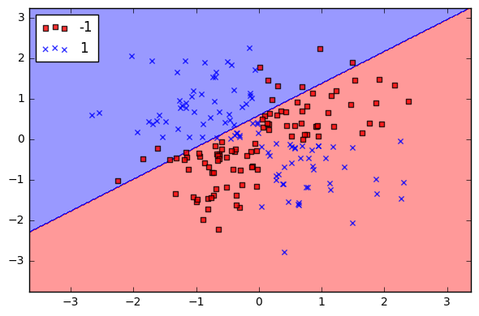
Support Vector Machine Basics
Supervised learning technique used for classification and regression analysis
- Input of train data (with known response variable)
- Creates a decision boundary between data points
- Separates data into distinct sets

Slide 3
Support Vector Machine Hyperplanes
A hyperplane is a subspace whose dimension is n-1 than the number of variables in the dataset
In 3-dimensional datasets, 2-dimensional planes are used to separate data into two distinct groups
There are many different hyperplanes that can classify data; however we want to find a hyperplane with the maximum margin
p-dimensional hyperplane
$$β_{0 }+β_{1}X_{1}+β_{2}X_{2}+…+β_{p}X_{p}=0$$

Slide 4
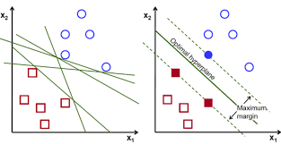
Maximum-margin Classifier
Creates separating hyperplane that is farthest from the first closest training observation
There is a boundary between the sides of the hyperplane and the width is known as the “margin”, which is maximized

Slide 5
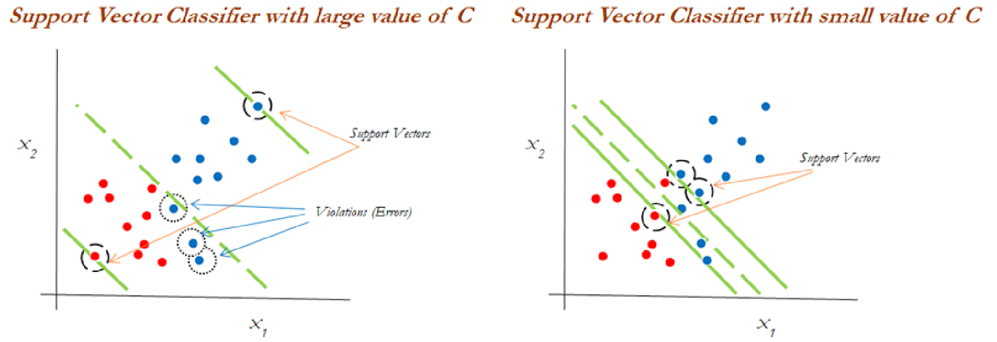
Support Vectors
We find that observations that lie on the margin, or those who violate the margin, are the only observations that affect the hyperplane
Observations that lie on the correct side of the margin do not influence the hyperplane at all
These observations on the wrong side of the margin are called “Support Vectors”

Slide 6
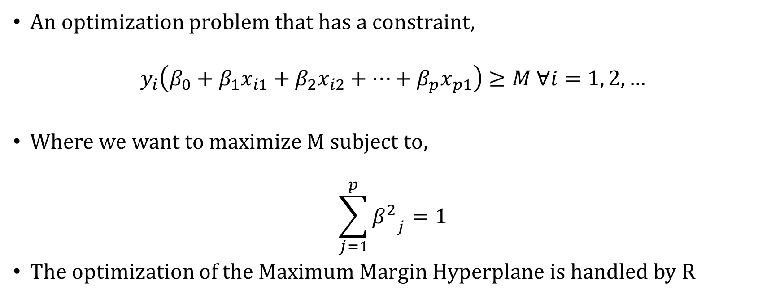
Creating the Maximum Margin Hyperplane
An optimization problem that has a constraint,
$$y_{i}\left(β_{0}+{β_{1}x}_{i1}+{β_{2}x}_{i2}+…+{β_{p}x}_{p1}\right)≥M ∀i=1, 2, …$$
Where we want to maximize M subject to,
$$\sum_{j=1}^{p}{{β^{2}}_{j}}=1$$
The optimization of the Maximum Margin Hyperplane is handled by R

Slide 7
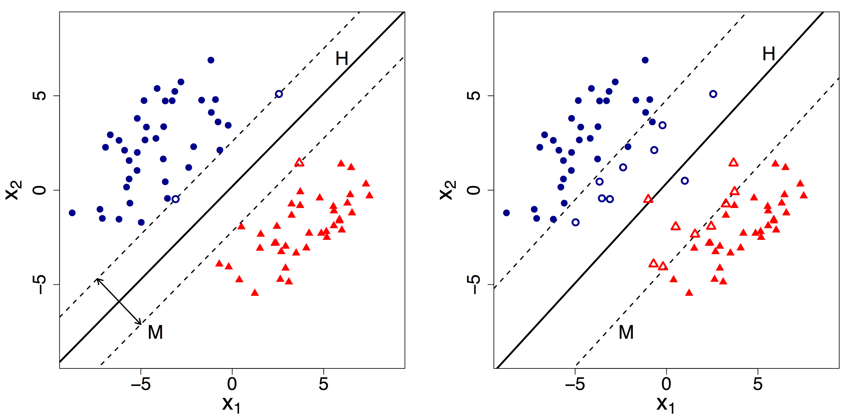
Support Vector Classifiers
Support Vector Classifier (soft margin classifier) is more robust and tends to be a better classifier than maximum margin classifier
Sometimes a perfect separation of data is not possible, therefore some observations could be on the incorrect side of the margin
We introduce a new slack variable $ε_{i}$ that allows individual data points to be in the wrong side of the margin.

Slide 8

Support Vector Classifiers Optimization
An optimization problem that has a constraint,
$$y_{i}\left(β_{0}+{β_{1}x}_{i1}+{β_{2}x}_{i2}+…+{β_{p}x}_{p1}\right)≥M\left(1−ε_{i}\right) ∀i=1, 2, …$$
Subject to,
$$\sum_{j=1}^{p}{{β^{2}}_{j}}=1$$
And a turning parameter C,
$$ε_{i}≥0, \sum_{i=1}^{n}{ε_{i}<C}$$
C bounds the sums of $ε_{i}$ and determines the number and severity of the violations in the margin region.

Slide 9
Support Vector Classifiers Optimization
C is treated as a tuning parameter
C balances the bias-variance trade-off seen in the dataset
Small Tuning Parameter
Narrow Margins
Few Violations
More Biased
Less Variance
Large Tuning Parameter
Wider Margins
More Violations
Less Biased
High Variance

Slide 10
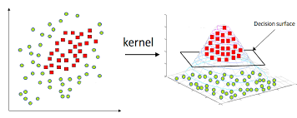
Support Vector Machine
Support Vector Machine is an extension of support vector classifier
Support Vector Machine expands the feature space by introducing kernels
Kernels removes the computational requirements for higher dimension vector spaces and allows us to deal with non-linear data
There are three common types of kernels: linear, polynomial, radial

Slide 11
Support Vector Machine Optimization
The linear support classifier has a solution function of,
$$f\left(x\right)= β_{0}+ \sum_{j=1}^{n}{α_{j}\left\langle x,x_{j}\right\rangle }$$
Where $α_{j}$ and $β_{0}$ are parameters measured by all the pairs of the inner products of the training data
$α_{j}$ is nonzero only for support vectors and $α_{j}$ is equal to zero if not
Thus, our solution function can be rewritten as,
$$f\left(x\right)= β_{0}+ \sum_{i∈S}{α_{j}\left\langle x,x_{j}\right\rangle }$$
Where S is the collection of support vectors which results in fewer computations

Slide 12
Generalization of Kernels
We can generalize our inner product by using a kernel seen as,
$$K\left(x_{i},x_{i^{′}}\right)= \sum_{j=1}^{p}{x_{ij}x_{i^{′}j}}$$
The kernel function can be transformed into a polynomial kernel of degree d,
$$K\left(x_{i},x_{i^{′}}\right)={(1+\sum_{j=1}^{p}{(x_{ij}x_{i^{′}j})})}^{d}$$
The solution function has the form,
$$f\left(x\right)=β_{0}+\sum_{i∈S}{α_{j}}K\left(x_{i},x_{i^{′}}\right)$$

Slide 13
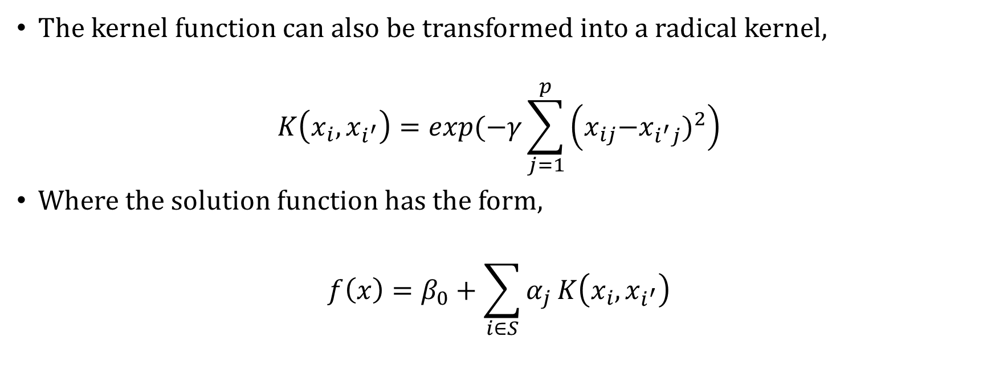
Generalization of Kernels
The kernel function can also be transformed into a radical kernel,
$$K\left(x_{i},x_{i^{′}}\right)=exp(−γ\sum_{j=1}^{p}{\left({x_{ij}{−x}_{i^{′}j})}^{2}\right)}$$
Where the solution function has the form,
$$f\left(x\right)=β_{0}+\sum_{i∈S}{α_{j}}K\left(x_{i},x_{i^{′}}\right)$$

Slide 14
Using Support Vector Machine in R
I used a dataset named spam7 that contains data whether an email is spam or not
The 6 predictors of the dataset were
crl.tot: total length of words in capitals
dollar: number of occurrences of the \$ symbol
bang: number of occurrences of the ! symbol
money: number of occurrences of the word ‘money’
n000: number of occurrences of the string ‘000’
make: number of occurrences of the word ‘make’
The response variable “yesno” was the indication whether it is spam or not
- yesno: outcome variable, a factor with levels n not spam, y spam

Slide 15
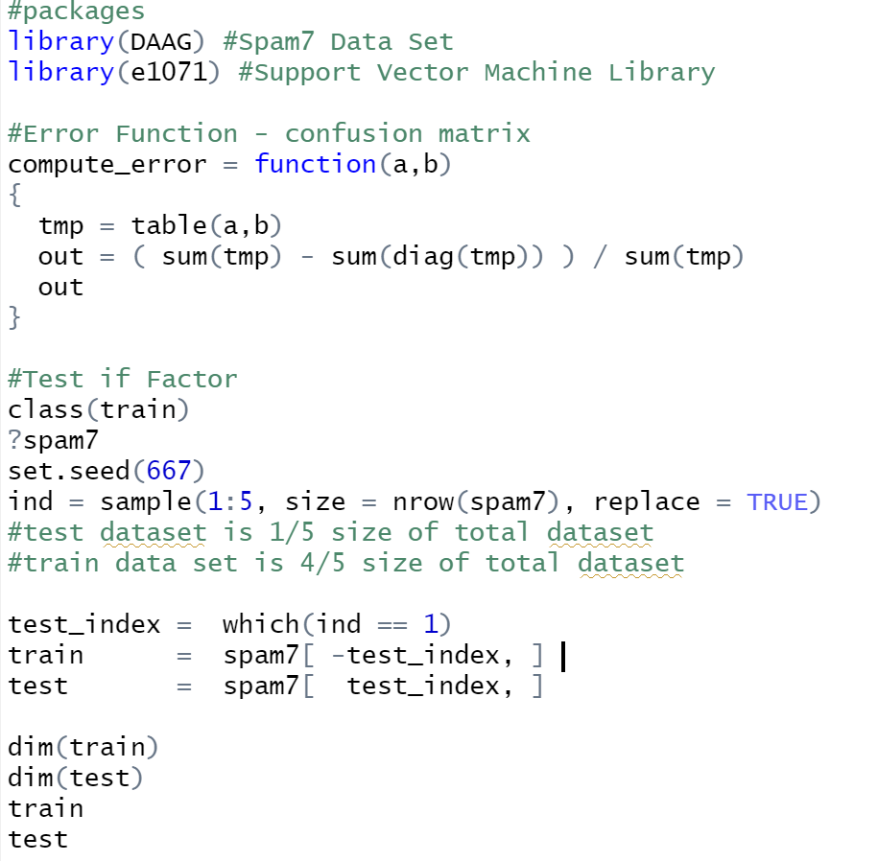
Sorting Train and Test data in R

Slide 16
First Prediction of Support Vector Machine Code
Support Vector Machine Code
#SVM Model
svm.spam = svm(yesno ~ . , data = train, kernel = 'linear', gamma = 1, cost = 1e5)
summary(svm.spam)
svm.spam$index
ypredict_1 = predict(svm.spam, test)
table(predict = ypredict_1, truth = test$yesno)
#Error of prediction
svm_svm_error = compute_error(test$y, ypredict_1)
svm_svm_error

Slide 17
Result
1399 Support Vectors
Linear Kernel
A confusion matrix is a table that displays the incorrect matches between the actual response and predicted response
From the confusion matrix, we can calculate the test error which are the diagonal points 19 and 153 over the total number of data points
We received a test error of 18.65%
 | True Value
Predicted Value |  | No | Yes
 | No | 542 | 153
 | Yes | 19 | 208

Slide 18
Tuned Support Vector Machine Code
R supports many tuning functions to reduce the test error in our models
Tuned Code
#Tuned model through cross validation
tune.out=tune(svm ,yesno ~ . ,data=train ,kernel = 'linear',
ranges=list(cost=c(.0001, 0.001, 0.01, 0.1, 1,5,10,100), gamma = c(0.001, 0.01, .1, 1) ))
tune.out
summary(tune.out)
bestmod = tune.out$best.model
summary(bestmod)
#Prediction through test data set
ypredict = predict(bestmod, test)
table(predict = ypredict, truth = test$yesno)
#Error of prediction
svm_bestmodel_error = compute_error(test$y, ypredict )
svm_bestmodel_error

Slide 19
Result
1531 Support Vectors
Polynomial Kernel
Best parameters obtained through using tuning; cost = 100 and Gamma = 0.001
After using our tuning function, we lowered our test error down to 14.52%
This meant that almost 9/10 predictions were correct using the support vector machine algorithm!
 | True Value
Predicted Value |  | No | Yes
 | No | 541 | 114
 | Yes | 20 | 247

